Slide 1
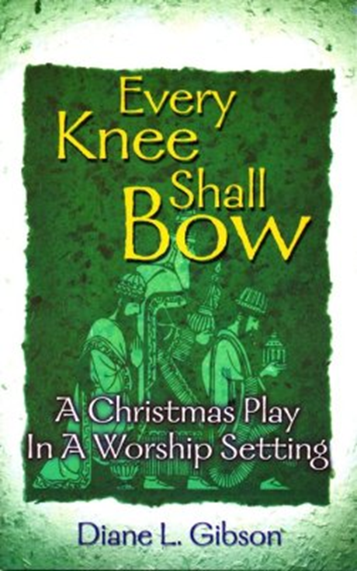
Second Sunday of Advent December 8, 2024
WELCOME!
Trinity Lutheran Church
Notes:
Image: Five Loaves by Caroline Coolidge Brown. Copyright © Caroline Coolidge Brown. All rights reserved. Used by permission of the artist.

Slide 2
= Please stand if able
= Please be seated
Prelude – by Roxanne Groff
Office of the Acolyte
Ringing of the Bell
Welcome

Slide 3
Lighting of the Advent Wreath
R: O Come, O Come Emmanuel.
C: We light this first candle in the hope of your coming.
R: We anticipate the time when you will pour out your spirit upon all flesh.
C: We light this second candle in love for you and our neighbors.
Notes:
Image: Preparing yeast dough. Copyright © tomasworks/iStock/Thinkstock. Used by permission.

Slide 4
Gathering Song/Hymn of Praise
“O Little Town of Bethlehem”
LBW 41
(First verse only)

Slide 5
“O Little Town of Bethlehem” LBW 41
1 O little town of Bethlehem,
how still we see thee lie!
Above thy deep and dreamless sleep
the silent stars go by;
yet in thy dark streets shineth
the everlasting light.
The hopes and fears of all the years
are met in thee tonight.

Slide 6
APOSTOLIC GREETING
P: The grace of our Lord Jesus Christ, the love of God, and the communion of the Holy Spirit be with you all.
C: And also with you.
Notes:
Image: Five Loaves by Caroline Coolidge Brown. Copyright © Caroline Coolidge Brown. All rights reserved. Used by permission of the artist.

Slide 7
PRAYER OF THE DAY
P: Let us pray… Almighty God, we heed Your call to return to you, and we seek your forgiveness. Renew our spirits and empower us to live in accordance with your ways. In Jesus’ name we pray.
C: Amen.
Notes:
Image: Five Loaves by Caroline Coolidge Brown. Copyright © Caroline Coolidge Brown. All rights reserved. Used by permission of the artist.

Slide 8
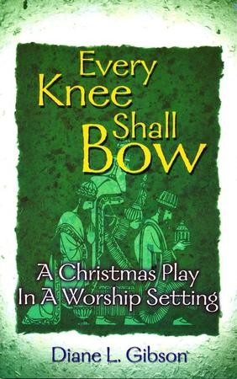
Introduction – PJ Musser
Notes:
Image: Five Loaves by Caroline Coolidge Brown. Copyright © Caroline Coolidge Brown. All rights reserved. Used by permission of the artist.

Slide 9
Scene 1: Come and Worship
Notes:
Image: Five Loaves by Caroline Coolidge Brown. Copyright © Caroline Coolidge Brown. All rights reserved. Used by permission of the artist.

Slide 10
“Hark the Herald Angels Sing” Verse 1
Hark! The herald angels sing,
"Glory to the newborn king;
peace on earth, and mercy mild,
God and sinners reconciled."
Joyful, all you nations, rise;
join the triumph of the skies;
with angelic hosts proclaim,
"Christ is born in Bethlehem!"
Notes:
Image: Five Loaves by Caroline Coolidge Brown. Copyright © Caroline Coolidge Brown. All rights reserved. Used by permission of the artist.

Slide 11
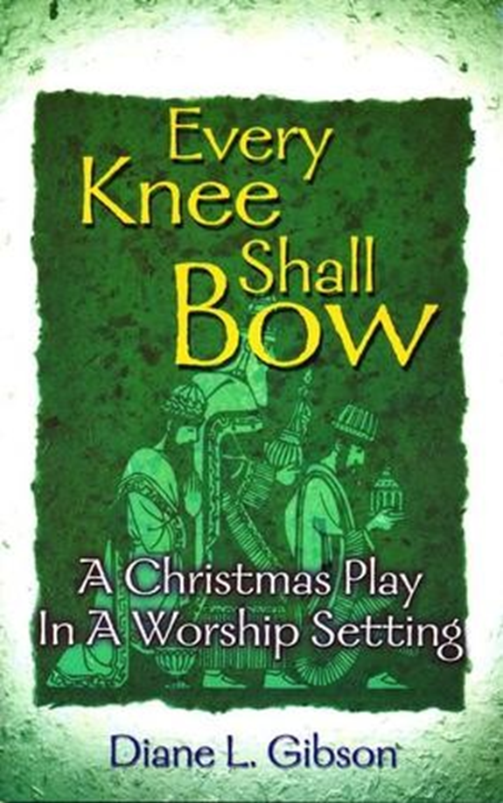
Scene 2 – The Groundskeeper
Notes:
Image: Five Loaves by Caroline Coolidge Brown. Copyright © Caroline Coolidge Brown. All rights reserved. Used by permission of the artist.

Slide 12
“Oh, Come all Ye Faithful” Verse 1
O come, all ye faithful, joyful and triumphant!
O come ye, O come ye to Bethlehem;
come and behold him,
born the king of angels:
Notes:
Image: Five Loaves by Caroline Coolidge Brown. Copyright © Caroline Coolidge Brown. All rights reserved. Used by permission of the artist.

Slide 13
“Oh, Come all Ye Faithful” Verse 1
Refrain
O come, let us adore him,
O come, let us adore him,
O come, let us adore him,
Christ the Lord!
Notes:
Image: Five Loaves by Caroline Coolidge Brown. Copyright © Caroline Coolidge Brown. All rights reserved. Used by permission of the artist.

Slide 14
Scene 3 – Mr. Executive
Notes:
Image: Five Loaves by Caroline Coolidge Brown. Copyright © Caroline Coolidge Brown. All rights reserved. Used by permission of the artist.

Slide 15
“Oh, Come all Ye Faithful” Verse 2
The highest, most holy,
light of light eternal,
born of a virgin,
a mortal he comes;
Son of the Father
now in flesh appearing!
Notes:
Image: Five Loaves by Caroline Coolidge Brown. Copyright © Caroline Coolidge Brown. All rights reserved. Used by permission of the artist.

Slide 16
“Oh, Come all Ye Faithful”
Refrain
O come, let us adore him,
O come, let us adore him,
O come, let us adore him,
Christ the Lord!
Notes:
Image: Five Loaves by Caroline Coolidge Brown. Copyright © Caroline Coolidge Brown. All rights reserved. Used by permission of the artist.

Slide 17
Scene 4 – The Christian Family
Notes:
Image: Five Loaves by Caroline Coolidge Brown. Copyright © Caroline Coolidge Brown. All rights reserved. Used by permission of the artist.

Slide 18
“Joy to the World” Verse 2
Joy to the earth,
the Savior reigns!
Let all their songs employ,
while fields and floods,
rocks, hills, and plains
repeat the sounding joy,
repeat the sounding joy,
repeat, repeat the sounding joy.
Notes:
Image: Five Loaves by Caroline Coolidge Brown. Copyright © Caroline Coolidge Brown. All rights reserved. Used by permission of the artist.

Slide 19
Scene 5 – The Rock Singers
Notes:
Image: Five Loaves by Caroline Coolidge Brown. Copyright © Caroline Coolidge Brown. All rights reserved. Used by permission of the artist.

Slide 20
“It came upon the midnight Clear” Verse 1
It came upon the midnight clear,
that glorious song of old,
from angels bending near the earth to touch their harps of gold:
"Peace on the earth, good will to all, from heav'n's all-gracious king."
The world in solemn stillness lay
to hear the angels sing.
Notes:
Image: Five Loaves by Caroline Coolidge Brown. Copyright © Caroline Coolidge Brown. All rights reserved. Used by permission of the artist.

Slide 21
Scene 6 – The Child
Notes:
Image: Five Loaves by Caroline Coolidge Brown. Copyright © Caroline Coolidge Brown. All rights reserved. Used by permission of the artist.

Slide 22
“Away in the Manager” Verse 1
Away in a manger,
no crib for his bed,
the little Lord Jesus
laid down his sweet head;
the stars in the bright sky
looked down where he lay,
the little Lord Jesus
asleep on the hay.
Notes:
Image: Five Loaves by Caroline Coolidge Brown. Copyright © Caroline Coolidge Brown. All rights reserved. Used by permission of the artist.

Slide 23
Scene 7 – The Football Player
Notes:
Image: Five Loaves by Caroline Coolidge Brown. Copyright © Caroline Coolidge Brown. All rights reserved. Used by permission of the artist.

Slide 24
“Oh Little Town of Bethlehem” Verse 2
For Christ is born of Mary,
and, gathered all above
while mortals sleep,
the angels keep
their watch of wond'ring love.
O morning stars, together
proclaim the holy birth,
and praises sing to God the king,
and peace to all the earth!
Notes:
Image: Five Loaves by Caroline Coolidge Brown. Copyright © Caroline Coolidge Brown. All rights reserved. Used by permission of the artist.

Slide 25
Scene 8 – The Questioning Child
Notes:
Image: Five Loaves by Caroline Coolidge Brown. Copyright © Caroline Coolidge Brown. All rights reserved. Used by permission of the artist.

Slide 26
“What Child Is This?” Verse 1
What child is this, who, laid to rest,
on Mary's lap is sleeping?
Whom angels greet
with anthems sweet
while shepherds watch are keeping? This, this is Christ the king,
whom shepherds guard
and angels sing;
haste, haste to bring him laud,
the babe, the son of Mary!
Notes:
Image: Five Loaves by Caroline Coolidge Brown. Copyright © Caroline Coolidge Brown. All rights reserved. Used by permission of the artist.

Slide 27
Special Music by Larry Harter
Characters
Voice of God- Micah Angles
Angel 1-Niki Angles
Angel 2- Rhyan Cool
Mr. Charles- Noah Harleman
Mr. Executive- Jackson Baker
Mr. Jones- Josh Schmitmeyer
Mrs. Jones- Kami Schmitmeyer
Tommy- Callie Schmitmeyer
Alice- Finley Schmitmeyer
Rock Singers- Pastor Mel & Crew Baker
Sarah- Ruby Baker
Football Player- Miles Baker
Young Boy- Gabe Angles
Passersby- Dean Thompson
Notes:
Image: Five Loaves by Caroline Coolidge Brown. Copyright © Caroline Coolidge Brown. All rights reserved. Used by permission of the artist.

Slide 28
PRAYERS OF INTERCESSION
Each petition will end with the words,
A: God, in your mercy,
The congregation will respond with:
C: hear our prayer.

Slide 29
PRAYERS OF INTERCESSION
The prayer concludes…
P: We lift up all of our prayers, spoken and unspoken to you. In Jesus’ name we pray.
C: Amen.

Slide 30
OFFERING
Notes:
Image: Five Loaves by Caroline Coolidge Brown. Copyright © Caroline Coolidge Brown. All rights reserved. Used by permission of the artist.

Slide 31
OFFERING PRAYER
Notes:
Image: Five Loaves by Caroline Coolidge Brown. Copyright © Caroline Coolidge Brown. All rights reserved. Used by permission of the artist.

Slide 32
THE LORD’S PRAYER
C: Our Father, who art in heaven, hallowed be thy name, thy kingdom come, thy will be done, on earth as it is in heaven. Give us this day our daily bread; and forgive us our trespasses, as we forgive those who trespass against us; and lead us not into temptation, but deliver us from evil.

Slide 33
THE LORD’S PRAYER
C: For thine is the kingdom, and the power, and the glory, forever and ever. Amen.

Slide 34
ANNOUNCEMENTS
Notes:
Image: Five Loaves by Caroline Coolidge Brown. Copyright © Caroline Coolidge Brown. All rights reserved. Used by permission of the artist.

Slide 35
SENDING BLESSING
P: The God of peace bless you, the love of Christ sustain you in hope, and the anointing of the Spirit ☩ remain upon you now and forever.
C: Amen.

Slide 36
Sending Song
“Good Christian Friends, Rejoice”
LBW 55
(1st Verse Only)
Notes:
Image: Five Loaves by Caroline Coolidge Brown. Copyright © Caroline Coolidge Brown. All rights reserved. Used by permission of the artist.

Slide 37
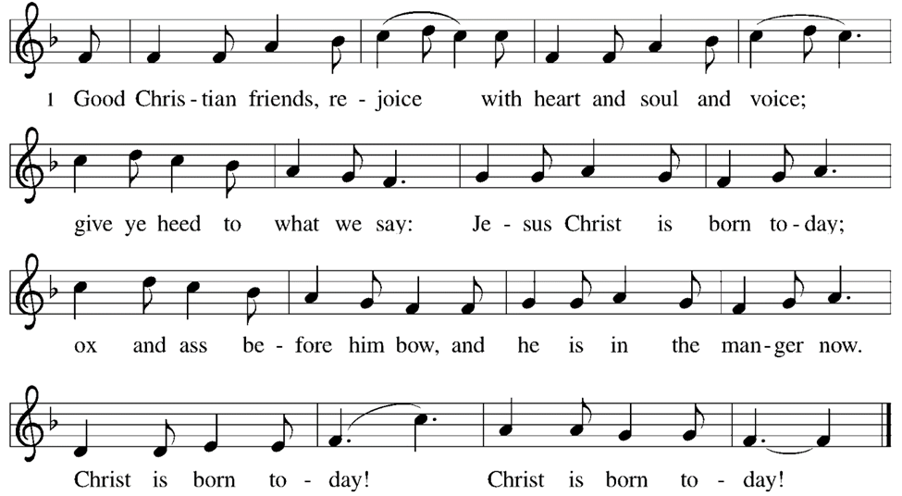
Good Christian Friends, Rejoice LBW 55
Notes:
Image: Preparing yeast dough. Copyright © tomasworks/iStock/Thinkstock. Used by permission.

Slide 38
DISMISSAL
P: … Depart in Christ’s Love.
C: Seeking, welcoming, and serving all. Amen!
POSTLUDE
By
Roxanne Groff
From sundaysandseasons.com. Copyright © 2024 Augsburg Fortress. All rights reserved. Reprinted by permission under Augsburg Fortress Liturgies Annual License #SAS023830. New Revised Standard Version Bible, Copyright © 1989, Division of Christian Education of the National Council of the Churches of Christ in the United States of America. Used by permission. All rights reserved. Revised Common Lectionary, Copyright © 1992 Consultation on Common Texts, admin Augsburg Fortress. Used by permission.

