Slide 1
August 25, 2024 Judgment Day Rally Day
WELCOME!
Trinity Lutheran Church
Notes:
Image: Five Loaves by Caroline Coolidge Brown. Copyright © Caroline Coolidge Brown. All rights reserved. Used by permission of the artist.

Slide 2
= Please stand if able
= Please be seated
Prelude - By Pam Sherman
Office of the Acolyte
Ringing of the Bell
Welcome

Slide 3
THANKSGIVING FOR BAPTISM
All may make the sign of the cross, the sign marked at baptism, as the presiding minister begins.
P: Blessed be the holy Trinity, ☩ one God, the fountain of living water, the rock who gave us birth, our light and our salvation.
C: Amen.
Notes:
Image: Preparing yeast dough. Copyright © tomasworks/iStock/Thinkstock. Used by permission.

Slide 4
P: Joined to Christ in the waters of baptism, we are clothed with God's mercy and forgiveness. Let us give thanks for the gift of baptism. Water may be poured into the font as the presiding minister gives thanks.
THANKSGIVING FOR BAPTISM
Notes:
Image: Preparing yeast dough. Copyright © tomasworks/iStock/Thinkstock. Used by permission.

Slide 5
P: We give you thanks, O God, for in the beginning your Spirit moved over the waters and by your Word you created the world, calling forth life in which you took delight. Through the waters of the flood you delivered Noah and his family. Through the sea you led your people Israel from slavery into freedom.
THANKSGIVING FOR BAPTISM
Notes:
Image: Preparing yeast dough. Copyright © tomasworks/iStock/Thinkstock. Used by permission.

Slide 6
P: At the river your Son was baptized by John and anointed with the Holy Spirit. By water and your Word you claim us as daughters and sons, making us heirs of your promise and servants of all. We praise you for the gift of water that sustains life, and above all we praise you for the gift of new life in Jesus Christ.
THANKSGIVING FOR BAPTISM
Notes:
Image: Preparing yeast dough. Copyright © tomasworks/iStock/Thinkstock. Used by permission.

Slide 7
P: Shower us with your Spirit, and renew our lives with your forgiveness, grace, and love. To you be given honor and praise through Jesus Christ our Lord in the unity of the Holy Spirit, now and forever.
THANKSGIVING FOR BAPTISM
C: Amen.
Notes:
Image: Preparing yeast dough. Copyright © tomasworks/iStock/Thinkstock. Used by permission.

Slide 8
CONFESSION AND FORGIVENESS
All may make the sign of the cross, the sign marked at baptism…
L: We confess our sins before God and one another.
Pause for silence and reflection.
L: Creator God,
Notes:
Image: Five Loaves by Caroline Coolidge Brown. Copyright © Caroline Coolidge Brown. All rights reserved. Used by permission of the artist.

Slide 9
CONFESSION AND FORGIVENESS
C: You have made all things good, but we do not always treat them as we ought. We disrespect ourselves, others, the world which you have lovingly crafted. We forget that we are your children, loved and redeemed. And we ignore your spirit to chase after our own desires. Have mercy and forgive us.
Notes:
Image: Five Loaves by Caroline Coolidge Brown. Copyright © Caroline Coolidge Brown. All rights reserved. Used by permission of the artist.

Slide 10
CONFESSION AND FORGIVENESS
L: God never lets us go, no matter how far we stray. Receive the promise of your redemption, the mark of your forgiveness and the spirit which sets you free. In the name of Jesus Christ.
C: Amen.
Notes:
Image: Five Loaves by Caroline Coolidge Brown. Copyright © Caroline Coolidge Brown. All rights reserved. Used by permission of the artist.

Slide 11
Gathering Song/Hymn of Praise
“Here I Am, Lord”
ELW 574

Slide 12
“Here I Am, Lord” ELW 574
1 "I, the Lord of sea and sky,
I have heard my people cry.
All who dwell in dark and sin
my hand will save.
I, who made the stars of night,
I will make their darkness bright.
Who will bear my light to them?
Whom shall I send?"
Notes:
Image: Five Loaves by Caroline Coolidge Brown. Copyright © Caroline Coolidge Brown. All rights reserved. Used by permission of the artist.

Slide 13
“Here I Am, Lord” ELW 574
Refrain
Here I am, Lord. Is it I, Lord?
I have heard you calling in the night.
I will go, Lord, if you lead me.
I will hold your people in my heart.
Notes:
Image: Five Loaves by Caroline Coolidge Brown. Copyright © Caroline Coolidge Brown. All rights reserved. Used by permission of the artist.

Slide 14
“Here I Am, Lord” ELW 574
2 "I, the Lord of snow and rain,
I have borne my people's pain.
I have wept for love of them.
They turn away.
I will break their hearts of stone,
give them hearts for love alone.
I will speak my word to them.
Whom shall I send?"
Notes:
Image: Five Loaves by Caroline Coolidge Brown. Copyright © Caroline Coolidge Brown. All rights reserved. Used by permission of the artist.

Slide 15
“Here I Am, Lord” ELW 574
Refrain
Here I am, Lord. Is it I, Lord?
I have heard you calling in the night.
I will go, Lord, if you lead me.
I will hold your people in my heart.
Notes:
Image: Five Loaves by Caroline Coolidge Brown. Copyright © Caroline Coolidge Brown. All rights reserved. Used by permission of the artist.

Slide 16
“Here I Am, Lord” ELW 574
3 "I, the Lord of wind and flame,
I will tend the poor and lame.
I will set a feast for them.
My hand will save.
Finest bread I will provide
till their hearts be satisfied.
I will give my life to them.
Whom shall I send?"
Notes:
Image: Five Loaves by Caroline Coolidge Brown. Copyright © Caroline Coolidge Brown. All rights reserved. Used by permission of the artist.

Slide 17
“Here I Am, Lord” ELW 574
Refrain
Here I am, Lord. Is it I, Lord?
I have heard you calling in the night.
I will go, Lord, if you lead me.
I will hold your people in my heart.
Notes:
Image: Five Loaves by Caroline Coolidge Brown. Copyright © Caroline Coolidge Brown. All rights reserved. Used by permission of the artist.

Slide 18
APOSTOLIC GREETING
P: The grace of our Lord Jesus Christ, the love of God, and the communion of the Holy Spirit be with you all.
C: And also with you.
Notes:
Image: Five Loaves by Caroline Coolidge Brown. Copyright © Caroline Coolidge Brown. All rights reserved. Used by permission of the artist.

Slide 19
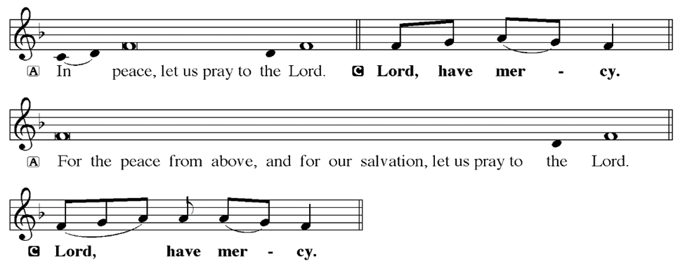
KYRIE
Notes:
Image: Five Loaves by Caroline Coolidge Brown. Copyright © Caroline Coolidge Brown. All rights reserved. Used by permission of the artist.

Slide 20
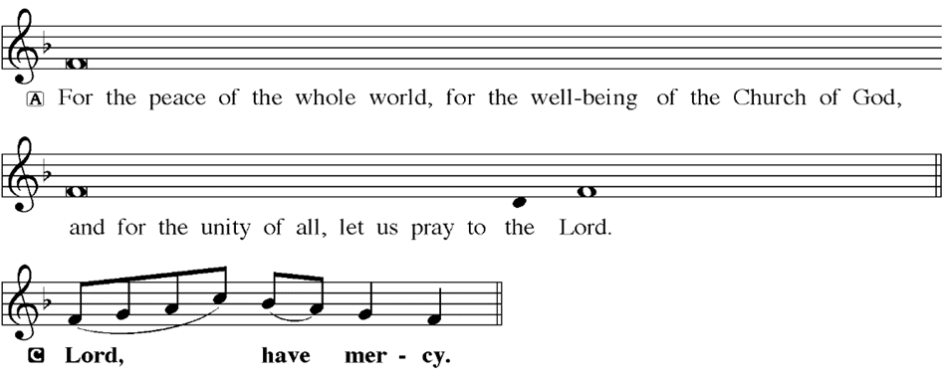
KYRIE
Notes:
Image: Five Loaves by Caroline Coolidge Brown. Copyright © Caroline Coolidge Brown. All rights reserved. Used by permission of the artist.

Slide 21
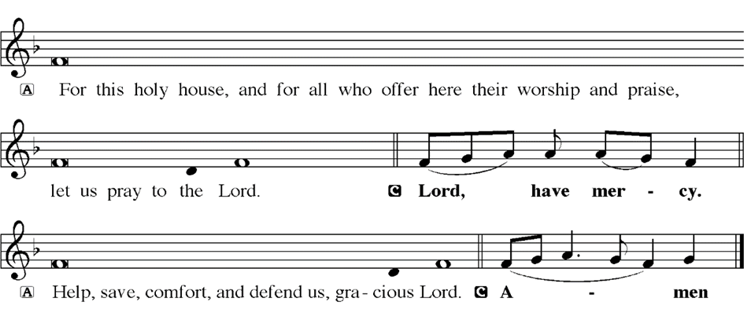
KYRIE
Notes:
Image: Five Loaves by Caroline Coolidge Brown. Copyright © Caroline Coolidge Brown. All rights reserved. Used by permission of the artist.

Slide 22
HYMN OF PRAISE
Glory be to God in heaven;
peace, goodwill to all the earth.
Mighty God of all creation,
Father of surpassing worth:
we exalt you, we adore you,
we lift high our thanks and praise.
Saints and angels bow before you; here on earth our songs we raise.
Notes:
Image: Five Loaves by Caroline Coolidge Brown. Copyright © Caroline Coolidge Brown. All rights reserved. Used by permission of the artist.

Slide 23
HYMN OF PRAISE
Glory be to Christ forever,
Lamb of God and Lord of love.
Son of God and gracious Savior, you have come from heav’n above;
on the cross you died to save us; now you reign at God’s right hand.
Hear our prayer; restore, forgive us; in your promise firm we stand.
Notes:
Image: Five Loaves by Caroline Coolidge Brown. Copyright © Caroline Coolidge Brown. All rights reserved. Used by permission of the artist.

Slide 24
HYMN OF PRAISE
Holy One we now acclaim you;
Lord alone, to you we call;
Holy One in faith we name you,
God most high, yet near to all:
Jesus Christ, with God the Spirit,
in the Father’s splendor bright.
For the peace that we inherit,
glory be to God on high!
Notes:
Image: Five Loaves by Caroline Coolidge Brown. Copyright © Caroline Coolidge Brown. All rights reserved. Used by permission of the artist.

Slide 25
PRAYER OF THE DAY
P: Let us pray… God of might, in the midst of our often-tumultuous lives—personally, communally, nationally, and internationally—remind us that no human power comes close to your divine power and eternal love. Claim us again as your beloved children and proclaim to us the promise of your everlasting deliverance. In Jesus’ name we pray.
C: Amen
Notes:
Image: Five Loaves by Caroline Coolidge Brown. Copyright © Caroline Coolidge Brown. All rights reserved. Used by permission of the artist.

Slide 26
• PRESENTATION OF BIBLES
Life of Jesus Bible
Spark Story Bible
Spark Gift Edition
Notes:
Image: Five Loaves by Caroline Coolidge Brown. Copyright © Caroline Coolidge Brown. All rights reserved. Used by permission of the artist.

Slide 27
BLESSING FOR THE NEW SCHOOL YEAR
BLESSING OF BACKPACKS
Notes:
Image: Five Loaves by Caroline Coolidge Brown. Copyright © Caroline Coolidge Brown. All rights reserved. Used by permission of the artist.

Slide 28
Notes:
Image: Five Loaves by Caroline Coolidge Brown. Copyright © Caroline Coolidge Brown. All rights reserved. Used by permission of the artist.

Slide 29
Scripture Reading
R: The Scripture reading for today is from the Book of Daniel, the 7th chapter.
C: Glory to you O’ Lord! (Spoken)
Notes:
Image: Five Loaves by Caroline Coolidge Brown. Copyright © Caroline Coolidge Brown. All rights reserved. Used by permission of the artist.

Slide 30
Daniel 7:1-18
In the first year of King Belshazzar of Babylon, Daniel had a dream and visions of his head as he lay in bed. Then he wrote down the dream: ²I, Daniel, saw in my vision by night the four winds of heaven stirring up the great sea, ³and four great beasts came up out of the sea, different from one another. ⁴The first was like a lion and had eagles’ wings. Then, as I
Notes:
Image: Five Loaves by Caroline Coolidge Brown. Copyright © Caroline Coolidge Brown. All rights reserved. Used by permission of the artist.

Slide 31
Daniel 7:1-18
watched, its wings were plucked off, and it was lifted up from the ground and made to stand on two feet like a human being; and a human mind was given to it. ⁵Another beast appeared, a second one, that looked like a bear. It was raised up on one side, had three tusks in its mouth among its teeth and was told, “Arise, devour many bodies!” ⁶After this, as I
Notes:
Image: Five Loaves by Caroline Coolidge Brown. Copyright © Caroline Coolidge Brown. All rights reserved. Used by permission of the artist.

Slide 32
Daniel 7:1-18
watched, another appeared, like a leopard. The beast had four wings of a bird on its back and four heads; and dominion was given to it. ⁷After this I saw in the visions by night a fourth beast, terrifying and dreadful and exceedingly strong. It had great iron teeth and was devouring, breaking in pieces, and stamping what was left with its feet. It was different from all
Notes:
Image: Five Loaves by Caroline Coolidge Brown. Copyright © Caroline Coolidge Brown. All rights reserved. Used by permission of the artist.

Slide 33
Daniel 7:1-18
the beasts that preceded it, and it had ten horns. ⁸I was considering the horns, when another horn appeared, a little one coming up among them; to make room for it, three of the earlier horns were plucked up by the roots. There were eyes like human eyes in this horn, and a mouth speaking arrogantly.
⁹As I watched, thrones were set in
Notes:
Image: Five Loaves by Caroline Coolidge Brown. Copyright © Caroline Coolidge Brown. All rights reserved. Used by permission of the artist.

Slide 34
Daniel 7:1-18
place, and an Ancient One took his throne, his clothing was white as snow, and the hair of his head like pure wool; his throne was fiery flames, and its wheels were burning fire. ¹⁰A stream of fire issued and flowed out from his presence. A thousand thousands served him, and ten thousand times ten thousand stood attending him. The court sat in
Notes:
Image: Five Loaves by Caroline Coolidge Brown. Copyright © Caroline Coolidge Brown. All rights reserved. Used by permission of the artist.

Slide 35
Daniel 7:1-18
judgment, and the books were opened. ¹¹I watched then because of the noise of the arrogant words that the horn was speaking. And as I watched, the beast was put to death, and its body destroyed and given over to be burned with fire. ¹²As for the rest of the beasts, their dominion was taken away, but their lives were prolonged for a season and a time.
Notes:
Image: Five Loaves by Caroline Coolidge Brown. Copyright © Caroline Coolidge Brown. All rights reserved. Used by permission of the artist.

Slide 36
Daniel 7:1-18
¹³As I watched in the night visions, I saw one like a human being coming with the clouds of heaven. And he came to the Ancient One and was presented before him. ¹⁴To him was given dominion and glory and kingship, that all peoples, nations, and languages should serve him. His dominion is an everlasting dominion that shall not pass away, and his
Notes:
Image: Five Loaves by Caroline Coolidge Brown. Copyright © Caroline Coolidge Brown. All rights reserved. Used by permission of the artist.

Slide 37
Daniel 7:1-18
kingship is one that shall never be destroyed.
¹⁵As for me, Daniel, my spirit was troubled within me, and the visions of my head terrified me. ¹⁶I approached one of the attendants to ask him the truth concerning all this. So he said that he would disclose to me the interpretation of the matter:
Notes:
Image: Five Loaves by Caroline Coolidge Brown. Copyright © Caroline Coolidge Brown. All rights reserved. Used by permission of the artist.

Slide 38
Daniel 7:1-18
¹⁷“As for these four great beasts, four kings shall arise out of the earth. ¹⁸But the holy ones of the Most High shall receive the kingdom and possess the kingdom forever—forever and ever.”
Notes:
Image: Five Loaves by Caroline Coolidge Brown. Copyright © Caroline Coolidge Brown. All rights reserved. Used by permission of the artist.

Slide 39
Daniel 7:1-18
R: This is the Word of the Lord.
C: Praise to You, O Christ (Spoken)
Notes:
Image: Five Loaves by Caroline Coolidge Brown. Copyright © Caroline Coolidge Brown. All rights reserved. Used by permission of the artist.

Slide 40
Sermon

Slide 41
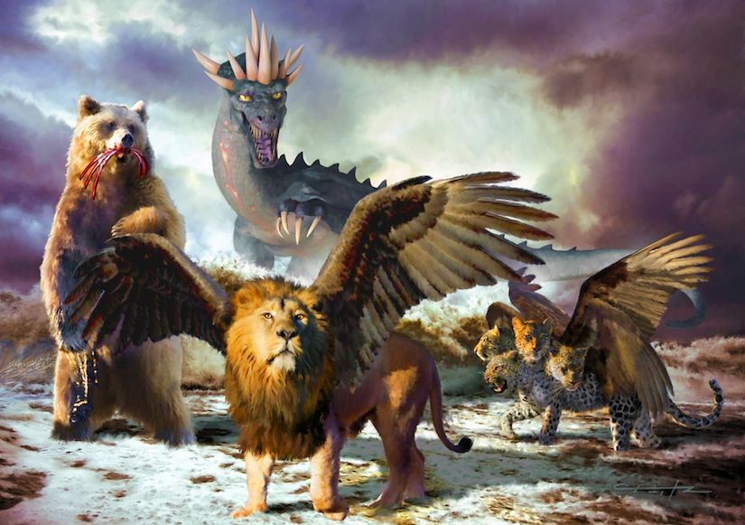
Sermon

Slide 42
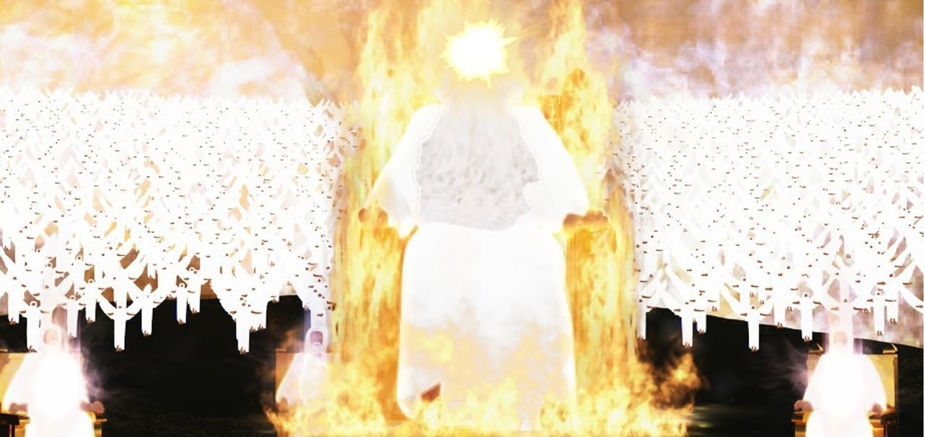
Sermon

Slide 43
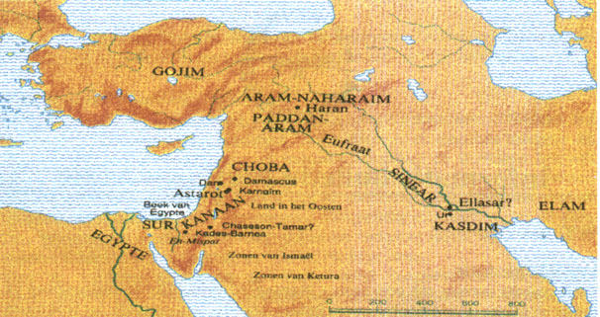
Sermon

Slide 44
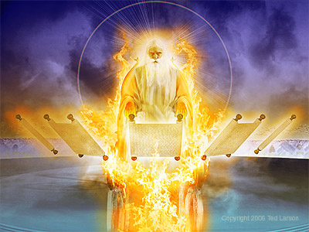
Sermon

Slide 45
Sermon

Slide 46
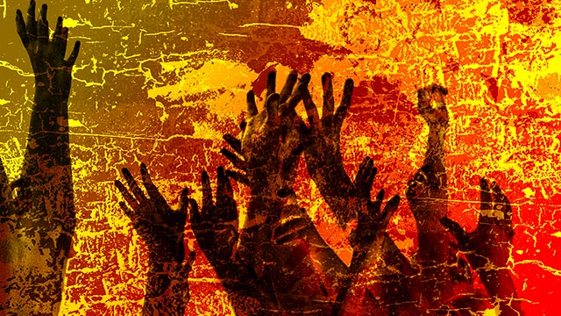
Sermon

Slide 47
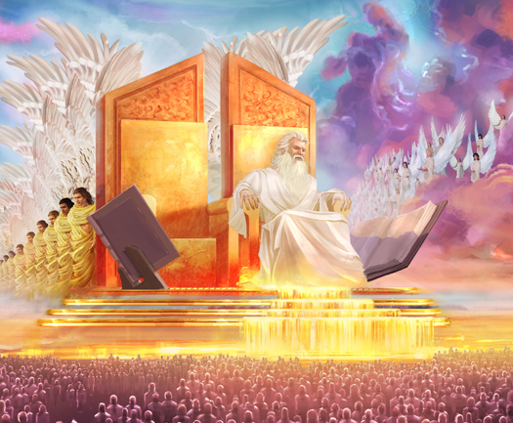
Sermon

Slide 48
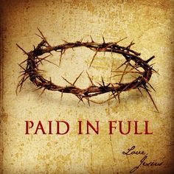

Slide 49
Hymn of the Day
“My Life Flows On In Endless Song”
ELW 763

Slide 50
“My Life Flows On In Endless Song” - ELW 763
1 My life flows on in endless song;
above earth's lamentation,
I catch the sweet, though far-off hymn
that hails a new creation.

Slide 51
“My Life Flows On In Endless Song” - ELW 763
Refrain
No storm can shake my inmost calm
while to that Rock I'm clinging.
Since Christ is Lord of heaven and earth,
how can I keep from singing?

Slide 52
“My Life Flows On In Endless Song” - ELW 763
2 Through all the tumult and the strife,
I hear that music ringing.
It finds an echo in my soul.
How can I keep from singing?

Slide 53
“My Life Flows On In Endless Song” - ELW 763
Refrain
No storm can shake my inmost calm
while to that Rock I'm clinging.
Since Christ is Lord of heaven and earth,
how can I keep from singing?

Slide 54
“My Life Flows On In Endless Song” - ELW 763
3 What though my joys and comforts die?
The Lord my Savior liveth.
What though the darkness gather round?
Songs in the night he giveth.

Slide 55
“My Life Flows On In Endless Song” - ELW 763
Refrain
No storm can shake my inmost calm
while to that Rock I'm clinging.
Since Christ is Lord of heaven and earth,
how can I keep from singing?

Slide 56
“My Life Flows On In Endless Song” - ELW 763
4 The peace of Christ makes fresh my heart,
a fountain ever springing!
All things are mine since I am his!
How can I keep from singing?

Slide 57
“My Life Flows On In Endless Song” - ELW 763
Refrain
No storm can shake my inmost calm
while to that Rock I'm clinging.
Since Christ is Lord of heaven and earth,
how can I keep from singing?

Slide 58
APOSTLE’S CREED
C: I believe in God, the Father almighty, creator of heaven and earth.

Slide 59
APOSTLE’S CREED
C: I believe in Jesus Christ, his only Son, our Lord. He was conceived by the power of the Holy Spirit and born of the virgin Mary. He suffered under Pontius Pilate, was crucified, died, and was buried.

Slide 60
APOSTLE’S CREED
C: He descended into hell. On the third day he rose again. He ascended into heaven, and is seated at the right hand of the Father. He will come again to judge the living and the dead.

Slide 61
APOSTLE’S CREED
C: I believe in the Holy Spirit, the holy catholic Church, the communion of saints, the forgiveness of sins, the resurrection of the body, and the life everlasting. Amen.

Slide 62
NICENE CREED
C: We believe in one God, the Father, the Almighty, maker of heaven and earth, of all that is, seen and unseen.

Slide 63
NICENE CREED
C: We believe in one Lord, Jesus Christ, the only Son of God, eternally begotten of the Father, God from God, Light from Light, true God from true God, begotten, not made, of one Being with the Father.

Slide 64
NICENE CREED
C: Through him all things were made. For us and for our salvation he came down from heaven; by the power of the Holy Spirit he became incarnate from the virgin Mary, and was made man. For our sake he was crucified under Pontius Pilate;

Slide 65
NICENE CREED
C: he suffered death and was buried. On the third day he rose again in accordance with the Scriptures; he ascended into heaven and is seated at the right hand of the Father. He will come again in glory to judge the living and the dead, and his kingdom will have no end.

Slide 66
NICENE CREED
C: We believe in the Holy Spirit, the Lord, the giver of life, who proceeds from the Father and the Son. With the Father and the Son he is worshiped and glorified. He has spoken through the prophets. We believe in one holy catholic and apostolic Church.

Slide 67
NICENE CREED
C: We acknowledge one Baptism for the forgiveness of sins. We look for the resurrection of the dead, and the life of the world to come. Amen.

Slide 68
QUILT TYING AND PRESENTATION
This Quilt has been lovingly made and prayed over especially for Keith Fourman

Slide 69
PRAYERS OF INTERCESSION
Each petition will end with the words,
A: God of mystery,
The congregation will respond with:
C: We lift our prayers to you.

Slide 70
PRAYERS OF INTERCESSION
The prayer concludes…
P: Confident in your life-giving love, we lift these prayers and all those in our hearts into your loving care.
C: Amen.

Slide 71
SHARING OF THE Peace
The Sharing of the Peace that began when the congregation arrived is now shared with the Pastor at this time...
P: The peace of the Lord be with you always.
C: And also with you.

Slide 72
OFFERING
Notes:
Image: Five Loaves by Caroline Coolidge Brown. Copyright © Caroline Coolidge Brown. All rights reserved. Used by permission of the artist.

Slide 73
OFFERING PRAYER
Notes:
Image: Five Loaves by Caroline Coolidge Brown. Copyright © Caroline Coolidge Brown. All rights reserved. Used by permission of the artist.

Slide 74
THE GREAT THANKSGIVING
All the Baptized are welcome to celebrate this Holy Meal.

Slide 75
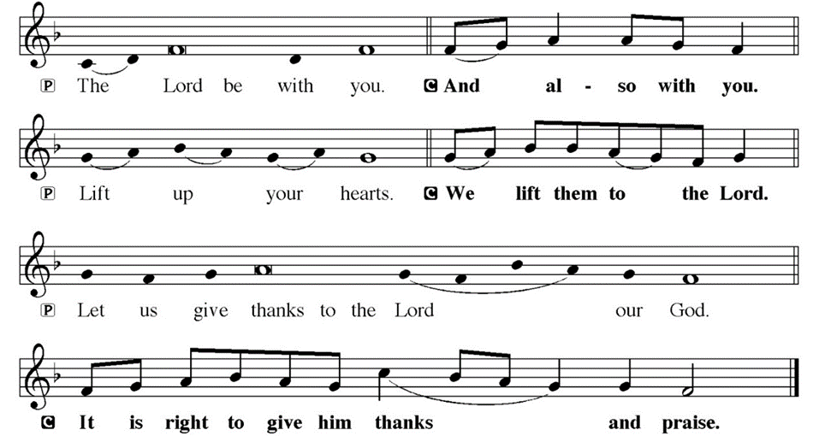
DIALOGUE

Slide 76
THE PREFACE
P: It is indeed right and salutary…
… we praise your name and join their unending hymn.

Slide 77
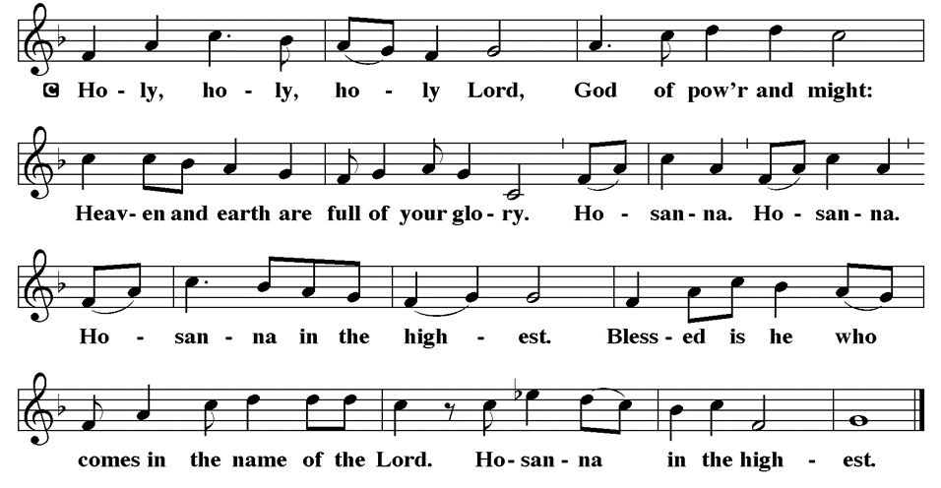
THE SANCTUS

Slide 78
EUCHARISTIC PRAYER
P: Holy God…
…both now and forever.
C: Amen.

Slide 79
THE LORD’S PRAYER
C: Our Father, who art in heaven, hallowed be thy name, thy kingdom come, thy will be done, on earth as it is in heaven. Give us this day our daily bread; and forgive us our trespasses, as we forgive those who trespass against us; and lead us not into temptation, but deliver us from evil.

Slide 80
THE LORD’S PRAYER
C: For thine is the kingdom, and the power, and the glory, forever and ever. Amen.

Slide 81
INVITATION TO COMMUNION
P: All the world belongs to God, and it is good! Come join in the feast of all creation, at the table set for all. Our God is good to us, and so we rejoice and proclaim this goodness to all the world. Come and be fed, children of God!

Slide 82
COMMUNION DISTRIBUTION
All will commune “By Station”.
The bread may be broken for distribution. As the ministers give the bread and wine, they say these words :
The body of Christ, given for you.
The blood of Christ, shed for you.
The communicant may say: Amen.

Slide 83
POST COMMUNION CANTACLE

Slide 84
POST COMMUNION CANTACLE

Slide 85
POST COMMUNION PRAYER
P: Let us pray… We thank you, generous God, for the refreshment we have received at your banquet table. Send us now to spread your generosity into all the world, through the one who is our dearest treasure, Jesus Christ, our Savior and Lord.
C: Amen

Slide 86
ANNOUNCEMENTS
Notes:
Image: Five Loaves by Caroline Coolidge Brown. Copyright © Caroline Coolidge Brown. All rights reserved. Used by permission of the artist.

Slide 87
SENDING BLESSING
P: The blessing of God, who provides for us, feeds us, and journeys with us, be upon you ☩ now and forever.
C: Amen.

Slide 88
Sending Song
“All Hail the Power of Jesus’ Name!”
LBW 328
Notes:
Image: Five Loaves by Caroline Coolidge Brown. Copyright © Caroline Coolidge Brown. All rights reserved. Used by permission of the artist.

Slide 89
“All Hail the Power of Jesus’ Name!” LBW 328
1 All hail the pow’r of Jesus’ name!
Let angels prostrate fall;
bring forth the royal diadem
and crown him Lord of all.
Bring forth the royal diadem
and crown him Lord of all.
Notes:
Image: Preparing yeast dough. Copyright © tomasworks/iStock/Thinkstock. Used by permission.

Slide 90
“All Hail the Power of Jesus’ Name!” LBW 328
2 Crown him, you martyrs of our God,
who from his altar call;
extol the stem of Jesse’s rod
and crown him Lord of all.
Extol the stem of Jesse’s rod
and crown him Lord of all.
Notes:
Image: Preparing yeast dough. Copyright © tomasworks/iStock/Thinkstock. Used by permission.

Slide 91
“All Hail the Power of Jesus’ Name!” LBW 328
3 O seed of Israel’s chosen race
now ransomed from the fall,
hail him who saves you by his grace
and crown him Lord of all.
Hail him who saves you by his grace
and crown him Lord of all.
Notes:
Image: Preparing yeast dough. Copyright © tomasworks/iStock/Thinkstock. Used by permission.

Slide 92
“All Hail the Power of Jesus’ Name!” LBW 328
4 Hail him, you heirs of David’s line,
whom David Lord did call--
the God Incarnate, man divine--
and crown him Lord of all.
The God Incarnate, man divine--
and crown him Lord of all.
Notes:
Image: Preparing yeast dough. Copyright © tomasworks/iStock/Thinkstock. Used by permission.

Slide 93
“All Hail the Power of Jesus’ Name!” LBW 328
5 Sinners, whose love can ne’er forget
the wormwood and the gall,
go spread your trophies at his feet
and crown him Lord of all.
Go spread your trophies at his feet
and crown him Lord of all.
Notes:
Image: Preparing yeast dough. Copyright © tomasworks/iStock/Thinkstock. Used by permission.

Slide 94
“All Hail the Power of Jesus’ Name!” LBW 328
6 Let ev’ry kindred, ev’ry tribe
on this terrestrial ball
to him all majesty ascribe
and crown him Lord of all.
To him all majesty ascribe
and crown him Lord of all.
Notes:
Image: Preparing yeast dough. Copyright © tomasworks/iStock/Thinkstock. Used by permission.

Slide 95
“All Hail the Power of Jesus’ Name!” LBW 328
7 Oh, that with yonder sacred throng
we at his feet may fall!
We’ll join the everlasting song
and crown him Lord of all.
We’ll join the everlasting song
and crown him Lord of all.
Notes:
Image: Preparing yeast dough. Copyright © tomasworks/iStock/Thinkstock. Used by permission.

Slide 96
DISMISSAL
P: … Depart in Christ’s Love.
C: Seeking, welcoming, and serving all. Amen!
POSTLUDE
By
Pam Sherman
From sundaysandseasons.com. Copyright © 2024 Augsburg Fortress. All rights reserved. Reprinted by permission under Augsburg Fortress Liturgies Annual License #SAS023830. New Revised Standard Version Bible, Copyright © 1989, Division of Christian Education of the National Council of the Churches of Christ in the United States of America. Used by permission. All rights reserved. Revised Common Lectionary, Copyright © 1992 Consultation on Common Texts, admin Augsburg Fortress. Used by permission.

